Slide 1
Developing Document-based Apps for Office
Name
Title
Company

Slide 2
Agenda
Introduction to Document-based App Development
Reading and Writing to a Document
Creating Bindings within a Document
Creating an App for Office that uses Custom XML
Design Guidelines for Document-centric Apps

Slide 3
Introduction to Document-based App Development

Slide 4
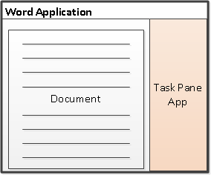
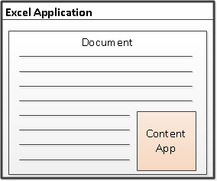
Shapes for Document-based Apps for Office
Task Pane App
Positioned to right of document
Used to assist user working with document
Can search and retrieve content from Internet
Content App
Adds content inline into position within document
Document is always an Excel workbook
Content app can read and write document contents
Notes:
There are two basic styles (i.e. shapes) for creating document-centric Apps for Office.
Task Pane Apps are document-centric and are designed to assist user working with documents.
Task pane apps can be used in Word, Excel and Project.
By default, task pane apps use 320px right on the right hand side of a document, but can be resized, moved, and even undocked from Office, the key being they are not part of the document…they assist the document
An example of task pane app might be for searching the Internet on links related to text selected in a document
Content Apps are document centric and are designed to add embedded content and functionality directly into a document.
Content apps are used exclusively with Excel 2013 so the associated document will always be an Excel workbook.
These apps can read and write to cells in the Excel workbook
An example might be a rich data visual that leverages a range of cells in an Excel Workbook

Slide 5



Support for Document-based Apps
 | Office Application | Office Web Application
Task Pane Apps
Content Apps
Notes:
One of the great things about Apps for Office is the ability for many of them to run both in the Office rich-client applications and the office web applications
Here you can see that Excel is the primary Office application supported in the Office Web Applications, and this is the case for both task pane and content apps in Excel
Lets take a closer look at how these apps run in the rich client and in Office Web Applications…NEXT SLIDE

Slide 6
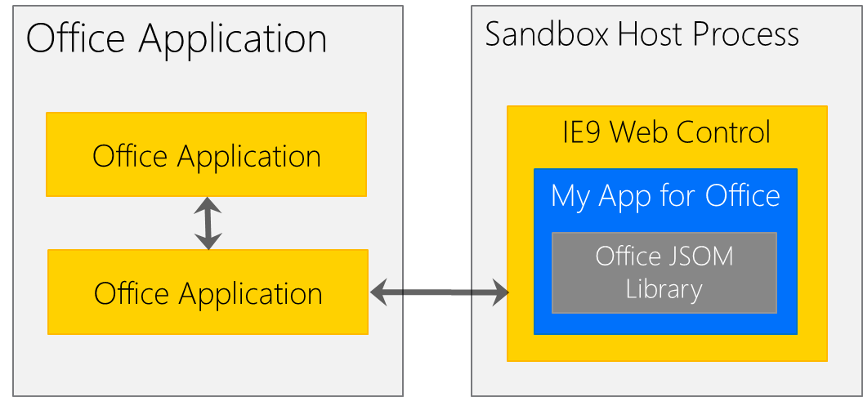
Apps for Office – Office Application Architecture
Apps for Office code run in separate sandboxed process
Sandbox infrastructure leverages Web Control from IE9/IE10
App for Office support for HTML5 and CSS3 consistent with IE9/IE10 support
Notes:
One of the keys to delivering document-centric Apps for Office is the Web Extensibility Framework runtime. This managed the app lifecycle and enabled interoperability between the between an app and its host, which could either be the Office 2013 rich-client application or the Office Web Apps.
The Web Extensibility Framework runtime essentially runs on the host and translates JavaScript API calls and events into native ones
In this diagram we are looking at the anatomy of an App for Office running in an Office 2013 rich-client application
The key takeaway is that the web artifacts of an App for Office run on any web server, but the web content will get rendered in a browser control which is hosted by a special sandbox process of the Office 2013 application
The sandbox process is going to provide security and performance isolation from the Office 2013 application

Slide 7
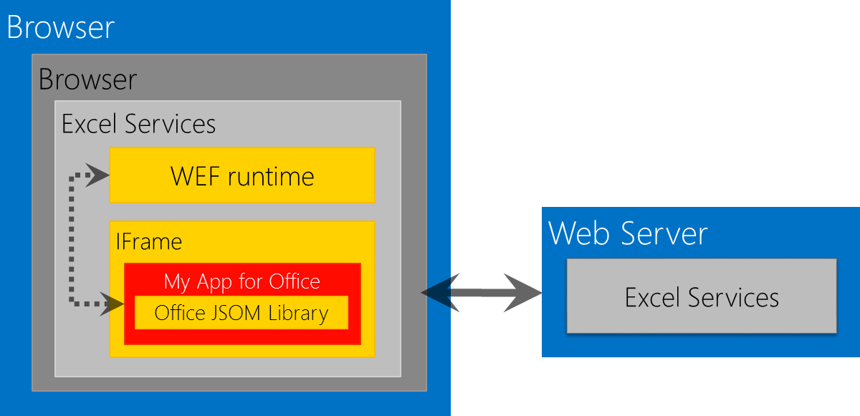
Apps for Office – Office Web Application Architecture
Browser-rendered Apps based on Web standards
Works across all popular browsers (might require the latest version)
App runs its it own iFrame inside outer an iFrame with WEF runtime
Communications between iFrames relies on HTML5 postMessage API
Notes:
For Office 2013 Web Apps, you have a similar model where the Web Extension Framework runtime is running from the host and managing lifecycle and communication between the host and the app…the big difference is the host is a web page rendered by the Office Web Apps and the app runs in an iFrame on that page
The cross-domain communication that occurs between the host web page and the App’s iFrame relies upon the HTML5 postMessage API
Another key difference is that since the hosts is a web page and not full-on Office, the Web Extensibility Framework runtime is enabled through the Office JavaScript library
I think an important point is that an App for Office leverages the same Office JavaScript Library regardless of where is runs…this gives a developer a build once development experience

Slide 8
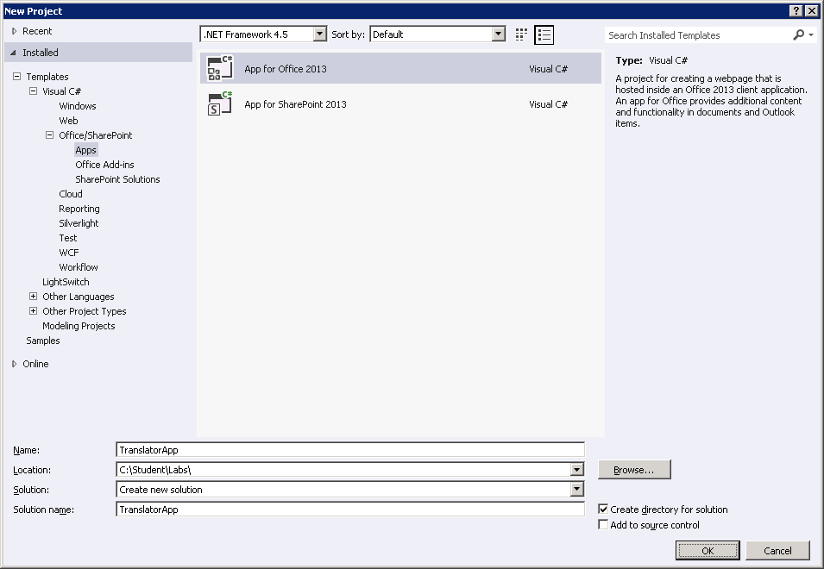
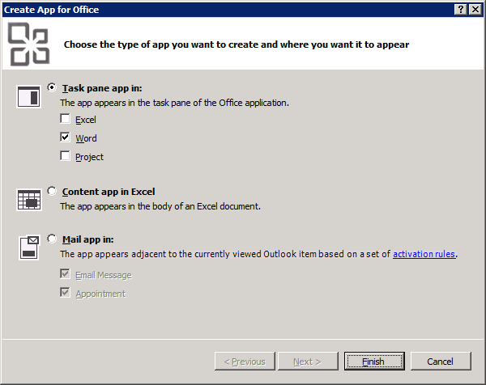
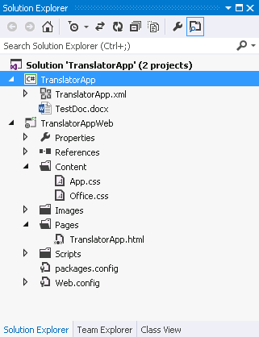
App Development with Visual Studio 2012 RC
Create new App for Office using the Apps for Office 2013 project template
Visual Studio create a new solution with two projects
Top project includes the app manifest for installation into a catalog
Bottom project is ASP.NET Website project know as Remote Web project
Modify Remote Web project source files with HTML, CSS and JavaScript
Press {F5} to test and debug
Notes:
The process for developing Apps for Office is very similar to developing other types of software in Visual Studio.
First, you will create a new project using a new “App for Office 2013” project template in Visual Studio 2012…this will walk you through a short wizard to understand the type of app you are building, but ultimately create a solution with two projects as you can in this slide…a project for the app manifest and a web project
Next, you will create the app user interface using HTML5 and CSS…the files will already be there
Once all the display elements have been created, you can add javascript to give the app some sort of behavior.
Finally, you will update the XML file which serves as the app manifest.
At this point, the app will be ready to debug and you can simply press the {F5} key to test and debug the app.

Slide 9

A common API for document-based Apps
Document-based Apps for Office have common objects
Used to read and write content to and from document
Used to create bindings and event handlers
Common Objects x-Office!
Picture
Charts
Clip Art
Hyperlink
Text
Table
Matrix
XML Parts
Word Art
Shapes
Notes:
Office 2013 provides a common JavaScript API for developing document-based apps.
This API provides a common set of objects used to read and write content to and from document.
The common API can also be used to create bindings and event handlers.
With Office 2013, the common API is only used across Word and Excel but there are plans to expand the common API and have it used by additional Office applications in later versions.

Slide 10
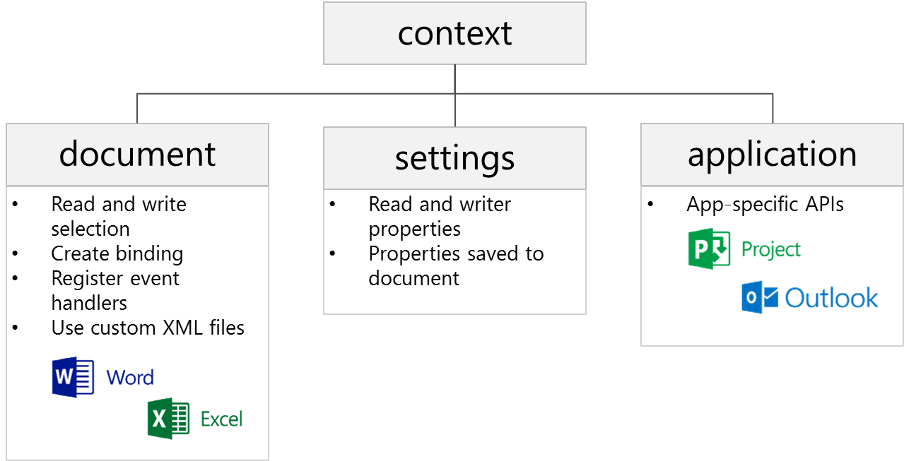
Core API Objects
Office.context
Entry point into Office API
Office.context.document
Common document API
Office.context.settings
Custom properties saved within document
Office.context.application
App-specific APIs (e.g. Project JSOM)
Notes:
The Office JavaScript object model provides a top-level object named Office with a context property which provides your entry point into the API. The context property provides three properties which expose the following objects.
Office.context.document provides access to the current document.
Office.context.settings provides access to a custom property bag allowing the developer to save and retrieve custom property settings
Office.context.application provides access to the entry points for app-specific APIs such as the APIs used to program against Microsoft Project and Outlook

Slide 11
Reading and Writing to a Document

Slide 12
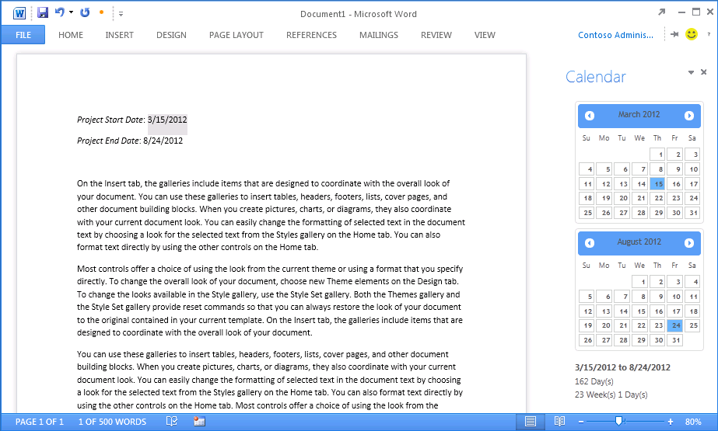
Interacting With Document Content
All data access starts through document object
Read/write access to user selection
Event handler for selection change event
Three data types are supported
Text
Matrix
Table
Notes:
All data access with word documents and excel workbooks starts through the Office.context.document object…this is the entry point for interation
It provides functions to read content from and write content to a document based on the current selection.
The document object also provides the means to wire up event handlers to fire when the user changes the current selection.
There are three primary data types that are supported when reading and writing data.
Text is a data type that represents a simple text value.
Matrix is a data type that supports a static 2D array of rows and columns.
Table is a data type that supports a dynamic 2D array with named columns and a set of rows that can be added and deleted.

Slide 13
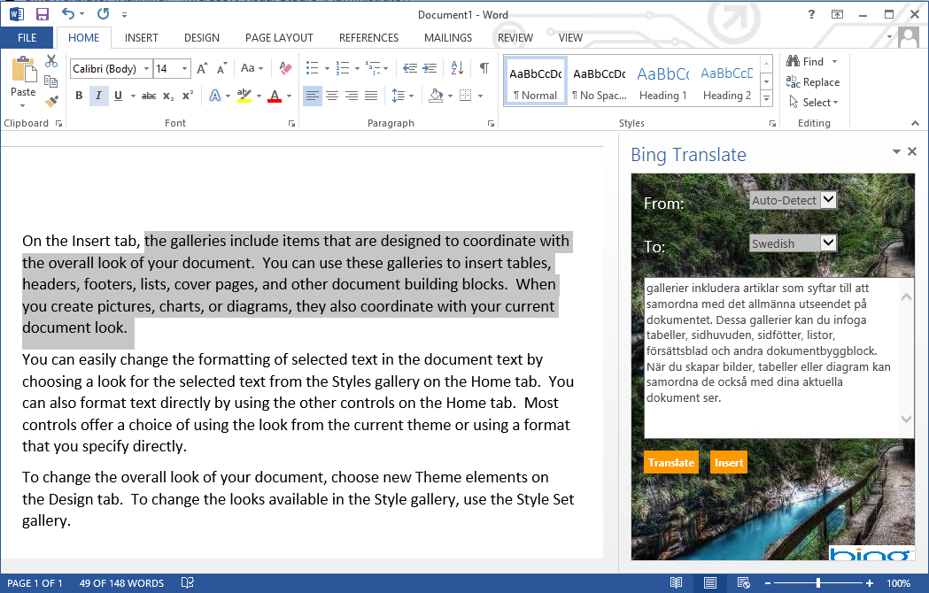
Working with ”text” Selections
Current selection
Task Pane App reads current selection and translates
Notes:
The Text data type is used for simple data interactions. For example, it can be used to read and write the current selection in a word document.
So if you wanted to do this, you can use the getSelectedDataAsync and setSelectedDataAsync methods on the document object
The document object also provides events for text selections. For example, you can register a JavaScript function as a event handler by calling the addHandlerAsync to receive callback when the SelectionChanged event is fired

Slide 14
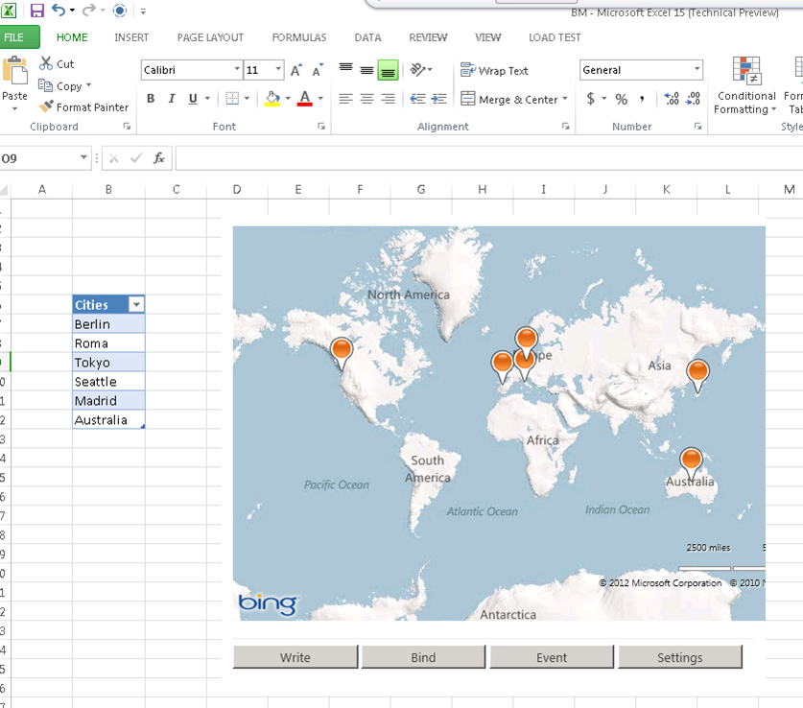
Working with ”table” Selections
Current selection
Content App reads current selection and translates
Notes:
Working with simple text is great, and a common scenario, especially for Word.
When working with task pane or content apps in Excel, it often makes sense to work with tables instead of simple text. This makes it possible to see a range of cells as a single data item with respect to reading and writing as well as hooking up an event handler to detect changes by the user.
A table also provides the user with the ability to add or delete rows which can trigger code inside the app to respond to those changes.
Content within a Table object can also be accessed using the getSelectedDataAsync method and setSelectedDataAsync method.
You can also register an event handler for the SelectionChanged event for a specific table instead of registering the event at the document level.

Slide 15
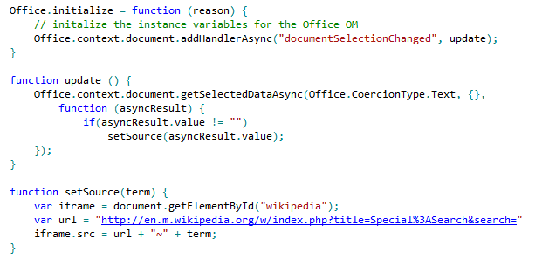
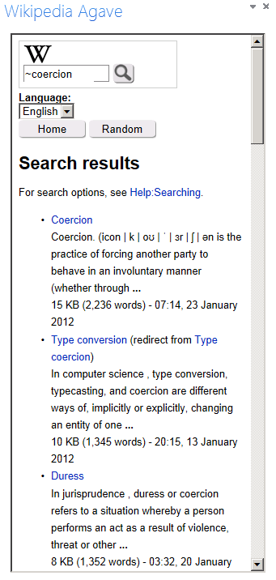
Getting Selected Data
Notes:
Here is a simple example of using events for getting selected text from a word document
The Office.initialize function has been implemented to register an event handler function named update that fires any time the user changes the selection in the current document.
The update function reads the current selection using the getSelectedDataAsync function using a coercion type of text and an anonymous function as the callback.
The anonymous function extracts the current selection from the results and sends it to a setSource function.
The setSource function appends the value of the current selection into a query string parameter at the end of an URL that does a lookup on the Wikipedia Web site and the results are added as the contents of an iFrame so they can be seen by the user.

Slide 16

Setting Selected Data
setSelectedDataAsync (data, {coercionType, asyncContext}, callback)
Use asyncResult parameter in callback function to verify call was successful
Passing data to setSelectedDataAsync
For text shape, pass data as string
For matrix shape, pass data using 2 dimensional JavaScript array
For table shape, pass data using TableData object
Coercion types can be used to convert string to/from HTML and OOXML
Dealing with table size when inserting data
If single cell selected: table of any size can be written
If range selected range, supplied array must match size of table being written
Notes:
You should use the document's setSelectedDataAsync method to write content back to a document. When calling the setSelectedDataAsync function, you will pass a callback function and use the asyncResult parameter in this callback function to verify call was successful
You must determine how to pass data when calling setSelectedDataAsync.
For text shape, you can pass data as a string.
For matrix shape, you should pass the data using 2 dimensional JavaScript array.
For a table shape, you should pass the data using a special TableData object which can be created using the Office JavaScript API.
Also note that with Word you can also use two additional coercion types which are HTML and OOXML.
There are a few tricks you should know about when dealing with matrix and table size when inserting data. If the user has selected a single cell selected, a matrix or table of any size can be written. However, if the user has select a range with two or more cells, the matrix or table must match the size of target range exactly with respect to the number of rows and columns.

Slide 17
Coercion Types
Content in binding/selection can be converted on read/write
Text
Matrix
Table
HTML
Office Open XML (OOXML)
Office.context.document.getSelectedDataAsync(‘ooxml’, etc…)
Notes:
There are five possible coercion types. In some cases, it should be obvious whether to use Text, Matric or Table.
HTML and OOXML are advanced coercion types that are only support in Word 2013 and not in Excel
If you want to see an example of these advanced coercion types, there is a great app in the Office Store that will convert a blank Word document into a specific print template such as mailing labels or name tags…this leverages the OOXML coercion type

Slide 18
Reading and Writing to a Document
demo

Slide 19
Creating Bindings within a Document

Slide 20
What are App Bindings?
Bindings link an App for Office to a specific document section
Can be defined current selection of a named item in a template
Arbitrarily read/write binding data at anytime
R/W operations do not depend on a selection.
Enable Event handling
Bindings support three different data shapes
Text binding for binding to an individual cell in Excel or text in word.
Matrix binding for a two dimension array representing rows and columns
Table binding is like a matrix binding with support for headers
Notes:
In Apps for Office, Bindings allows an app to lock in to a specific section within a document.
A binding can be created based on the current selection.
A binding can also be defined used a named item such as a named range in an Excel workbook or a bookmark in a Word document.
A binding adds value by providing a named section that can be read from or written to regardless of what the current selection is.
A binding also support events so you can add an event handler that detects when the user has made a change to the content inside a binding.
Bindings support three different data shapes.
Text bindings are used for binding to an individual cell in Excel or text in word.
Matrix bindings are used for a two dimension array representing rows and columns.
Table bindings are used to support Excel tables with named columns and a set of rows that support inserts and deletions by the user.

Slide 21
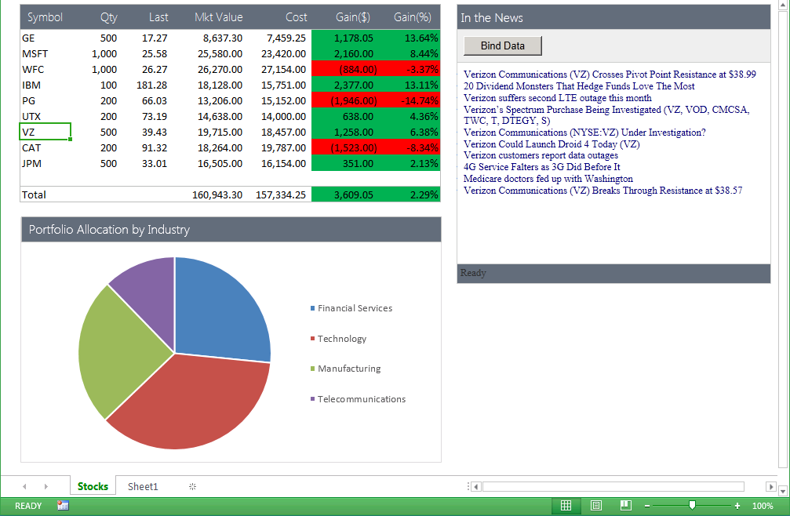
Uses of Apps for Office Bindings
App handles SelectionChanged event associated with the binding to retrieve news associated with stock symbol
Bound range of stock symbols
Notes:
Bindings provide a scope which allows an app to distinguish between selection changes or updates at the document level or just within a specific section of a document. Therefore, bindings can bridge the gap between Office documents and the cloud.
Bindings are also key in reading and writing data and detecting changes made by the user.

Slide 22
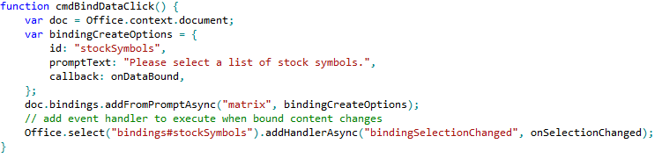
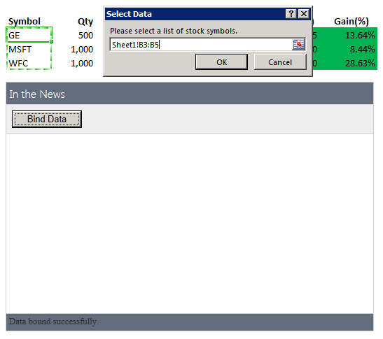
Using Bindings
Adding a binding
Bindings.addFromPromptAsync
Bindings.addFromSelectionAsync
Bindings.addFromNamedItem
Referencing a binding
Bindings.getAllAsync
Bindings.getByIdAsync
Office.Select
Removing a binding
Bindings.releaseByIdAsync
Binding event handler to a binding
Binding.addHandlerAsync(“type”, handler);
A dialog is presented to the user experience when you call addFromPromptAsync.
Notes:
To add a binding, you should use one of the following method of the office.content.document object
Bindings.addFromPromptAsync
Bindings.addFromSelectionAsync
Bindings.addFromNamedItem
You will also need to reference bindings to read and write content and register event handlers. When you need to reference a binding, you can use one of these method.
Bindings.getAllAsync
Bindings.getByIdAsync
Office.Select
If you ever need to remove a binding, you can use this methods.
Bindings.releaseByIdAsync
To register an event handler on a binding, you can use the following method.
Binding.addHandlerAsync(“type”, handler);

Slide 23
Binding to Cells and Tables in Excel Spreadsheets
demo

Slide 24
Creating an App for Office that uses Custom XML

Slide 25
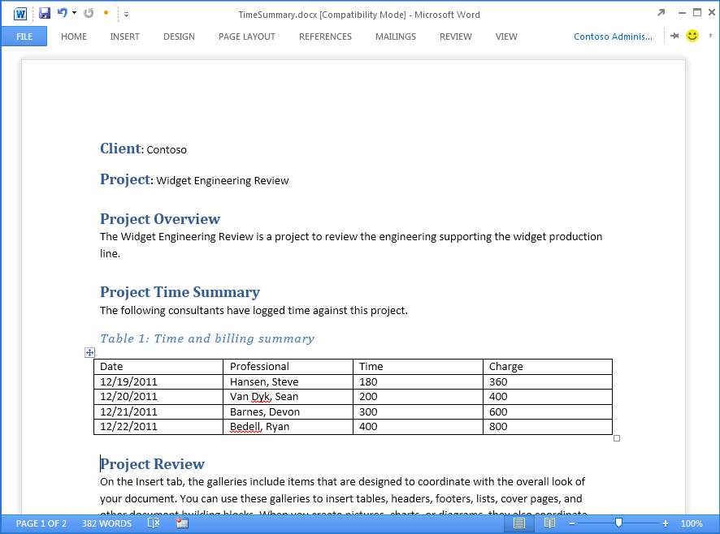
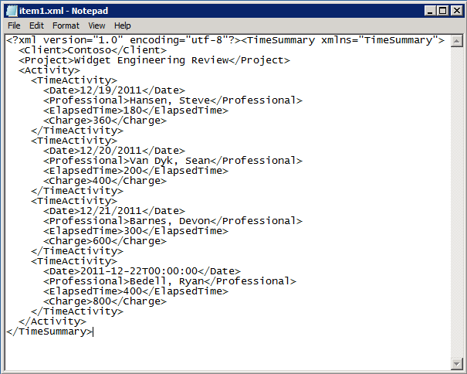


Open XML and Content Control Refresher
The TimeSummary document contains custom XML document
Inner XML document contains elements bound to Word Content Controls
Custom XML document can be modified/updated by your app
Custom XML document can be modified by user input
Word file structure
_rels
customXml
Content Controls mapped to custom XML part
docProps
word
Content Types
Notes:
Microsoft Word intorduced Content Controls in Office 2007. Content controls act as containers and user input controls for specific kinds of content. A valuable role of content controls is that they can be mapped to nodes within a custom XML part, which is a custom XML file embedded within a Office document such as a DOCX file..
With Office 2013, there is a new content control for repeating sections. A Repeating Section content control provides the capability to bind to a collection of nodes which typically represent the many side on a one-to-many relationship
This can be seen in the example on this slide where a project for a specific client has many time activities
Notice the custom xml on the right and how it makes to the content controls within on the document to the left

Slide 26
App for Office Support for Custom XML Parts
Things an App for Office can do
Add/delete custom XML parts
Get XML parts
Get/set node values
Event handlers for node deleted, inserted, or replaces
Core objects for working with custom XML parts
CustomXmlPart
CustomXmlParts
CustomXmlNode
CustomXmlPrefixMappings
Notes:
Since Office 2007 introduced files built using the Office Open XML structure, Microsoft Word has supported embedding one or more custom XML documents within a DOCX file known as a custom XML part.
A task pane app can be written to add, replace, update or delete a custom XML part.
An app can also retrieve a specific XML part using an XML namespace and get or set specific node values.
Furthermore, an app can register an event handler that fires whenever there is a user action which results in a node being deleted, inserted, or replaced.
The Office API provide a core set of objects for working with custom XML parts which includes the following.
CustomXmlPart
CustomXmlParts
CustomXmlNode
CustomXmlPrefixMappings

Slide 27
Working with Custom XML and Content Controls in a Word Document
demo

Slide 28
Design Guidelines for Document-centric Apps

Slide 29
User Experience Guidelines
Recommended guidelines
Use Office styles
Microsoft to publish User Experience Guidelines documentation
Design and Test for All Scenarios
Rich client, Browser, Tablet and Mobile
Decide which technology makes sense
Weigh pros and cons between HTML5, Silverlight and Flash
Notes:
Microsoft has published recommended guidelines for designing and implementing centric Apps for Office.
These guidelines include using Office styles and user interface experience standards.
You should keep in mind that you must design and test all the scenarios you plan to support which might include UI experience for the browser, for tablets and mobile devices in addition to the UI experience in the standard Office applications themselves.
You should also consider and make decisions about which Web technology makes sense to use. While HTML5 makes the most sense, you should understand that other Web technologies such as Silverlight and Flash can also be used in specific scenarios to achieve what cannot be done or what cannot be done easily with HTML5. You could even leverage server-side web technologies since Office just needs to know a web entry point into the app

Slide 30
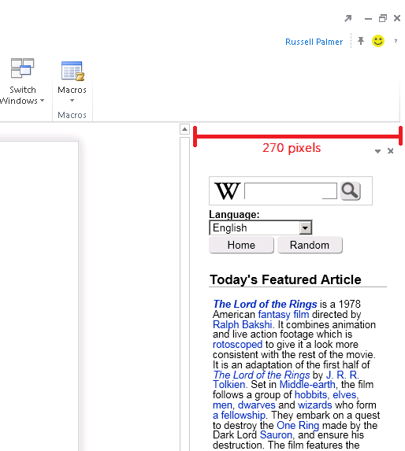
Guidelines for Designing Task Pane Apps
320
Layout Guidance
Default width of 320 pixels
Developer cannot change width
Users can resize width of task pane
Context Menus
Developer has control of context menu inside an App
Developer has no control over Office Task Pane menu
Scrollbar Guidance
Horizontal scrollbars should be avoided.
Vertical scrollbars are acceptable if required
Use CSS to match styles of Office 2013 scrollbar
Notes:
Microsoft has made specific recommendations for task pane apps with regard to layout guidance.
The default width of a task pane app is 320 pixels. As a developer you cannot change that width with HTML, CSS or JavaScript.
To make things even more challenging, the user can resize the width, move, and even undock a task pane, all of which could effect the width your task pane app.
Therefore, make sure you test your app by resizing and ensure that the user experience does not break down.
As a developer of a task pane app, you can add custom menus to the context menu of an app located at the top-right corner. However. You have no control over the top-level Office Task Pane menu nor do you have control over any other menus within the Office UI. Basically, the app can’t reach outside of itself
There is also strict guidance with respect to scrollbars. Horizontal scrollbars should be avoided at all costs. You should also try an avoid the use of vertical scrollbars if possible, although they are acceptable if required. Remember to use the styles inside the styles.css file to match styles of standard Office 2013 scrollbar.

Slide 31
Guidelines for Designing Content Apps
Layout Guidance
Content apps have generous size (max of 2560 x 2048)
Users can resize and move so design accordingly
Remember – content may print with the document
Context Menus
Developer has control of the context menu inside an app
However, you can not take over, or add to the Shape context menu.
Scrollbar Guidance
Scrollbars should be avoided within a Content App
Size them appropriately within the manifest.
Notes:
Microsoft has made specific recommendations for content apps with regard to layout guidance.
You must specify the width and height for a content app and the max size and width are quite large.
The max width is 2560 pixels and the max height is 2048 pixels
As a developer you cannot change that width and height after the content app has been added so make sure it is large enough to begin width.
Also keep in mind that the user can resize the width and height of ac content app. Therefore, make sure you test your app by resizing and ensure that the user experience is the best it can be.
As a developer of a content app, you can add custom menus to the context menu of an app located at the top-right corner. However. You have no control over any other menus within the Office UI.
There is also strict guidance with respect to scrollbars. All scrollbars should be avoided at all costs, period. If you feel that you need scrollbars, then you need to make the initial width and height larger so your app does not require them.

Slide 32
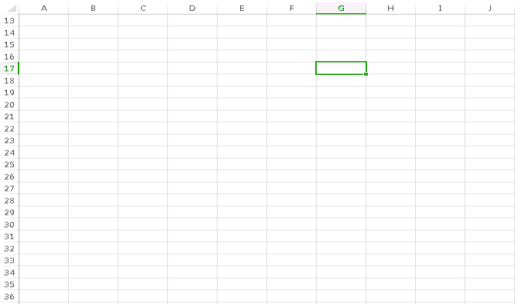
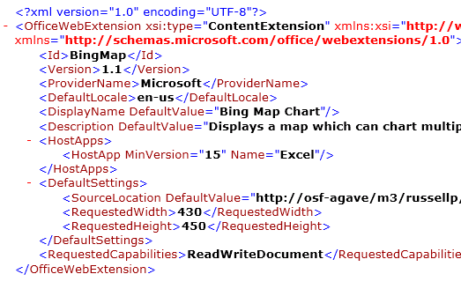
Guidelines for Designing Content Apps
Set an appropriate size
Specify an appropriate size for the App in the Manifest
This example is sized to small
resize to avoid scrollbars
Notes:
It important when designing a content app to set an appropriate size for a width and height in in the app manifest. This example shows an example of a content app that has been sized to small. The width and height should be changed to remove any need for scrollbars.

Slide 33
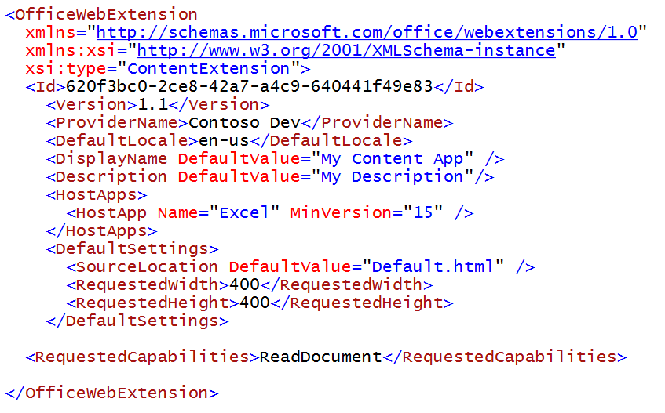
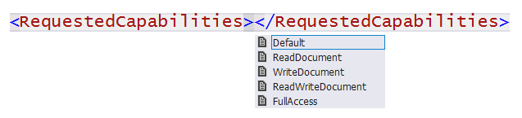
RequestedCapabilities
Default (restricted)
You can read/write document settings
ReadDocument
You have read access to document
You can subscribe to change events
WriteDocument
Write content into document
ReadWriteDocument
ReadDocument + WriteDocument
FullAccess
All Permissions + use of Silverlight & Flash
Notes:
The last things to think about is how much permission an app need to completed its work. You should try and limit the requested permissions to the absolute minimum. It is a design mistake to request more permissions than you app actually needs. Here is a breakdown of the available permission levels you can request in the RequestedCapabiliites element inside the app manifest.
Default (restricted) allows you to read and write document settings but provides no access to the content within the document itself.
ReadDocument allows read access to document as well as read/write access to document settings and the ability to create bindings and register for document level events
WriteDocument allows write access to document at the current selection as well as read/write access to document settings. However the app cannot read any contents of the document itself.
ReadWriteDocument provides the combined permissions of ReadDocument and WriteDocument together
FullAccess provides all permissions of ReadWriteDocument plus the right to use other Web technologies such as Silverlight or Flash within the app.

Slide 34
Summary
Introduction to Document-based App Development
Reading and Writing to a Document
Creating Bindings within a Document
Creating an App for Office that uses Custom XML
Design Guidelines for Document-centric Apps

Slide 35
Q&A

Slide 36

© 2012 Microsoft Corporation. All rights reserved. Microsoft, Windows, Windows Vista and other product names are or may be registered trademarks and/or trademarks in the U.S. and/or other countries.
The information herein is for informational purposes only and represents the current view of Microsoft Corporation as of the date of this presentation. Because Microsoft must respond to changing market conditions, it should not be interpreted to be a commitment on the part of Microsoft, and Microsoft cannot guarantee the accuracy of any information provided after the date of this presentation. MICROSOFT MAKES NO WARRANTIES, EXPRESS, IMPLIED OR STATUTORY, AS TO THE INFORMATION IN THIS PRESENTATION.

